Slide 1
Harnessing the Power of Synthetic Data for Improved Predictive Analysis
January 30, 2023
Thomas Houze
Program Officer
Preclinical, DAIDS, NIAID
Notes:
Welcome the title of this presentation is: “Harnessing the Power of Synthetic Data for Improved Predictive Analysis”

Slide 2
Introduction
This presentation will focus on handling imbalanced data sets using synthetic data and AI/ML-enhanced predictive modeling. Imbalanced data sets can result in biased models that primarily focus on the majority class, leading to misclassifications of the minority class and potential consequences in real-world scenarios. Different techniques and strategies for addressing this issue will be explored with illustrations of the pros and cons of each approach, providing insights and guidance for those looking to handle imbalanced data sets effectively by providing practical knowledge.
Notes:
Welcome to this presentation on how to best handle imbalanced data sets. Imbalanced data sets pose a significant challenge in predictive modeling as they can result in biased models that primarily focus on the majority class. This can lead to misclassifications of the minority class, which can have serious consequences in many real-world applications. In this presentation, I will explore various techniques and strategies for addressing this issue and discuss their pros and cons.

Slide 3
The “Red Wine Quality” Dataset is Multi-Class & Imbalanced
In this presentation, the "Red Wine Quality" dataset from Kaggle was used to demonstrate synthetic data and AI/ML techniques. It is a multi-class imbalanced dataset where wine quality scores ranging from 0-10 are the data classes. The aim is to predict the wine quality based on various wine attributes. Predictive AI/ML machine learning models are applied with and without Grid Search optimization and with and without the ADASYN (SMOTE) technique. The models used include K Nearest Neighbors (KNN), Gaussian Naive Bayes, Logistic Regression, and XGradient Boosting. Data exploration was conducted using Python and cross-validation with and without Grid Search, which is used to auto-optimize model performance.
Notes:
In this presentation, the "Red Wine Quality" dataset of the Kaggle data repository was used because it is a multiclass imbalanced dataset that contains the various attributes of red wine samples, along with the quality score of each wine on a scale of 0-10. This data set is interesting because it includes not just the chemical properties of the wines, such as pH, alcohol content, and citric acid and sulfur content, but also has a subjective target attribute, "quality," which represents the various classes of the wines and is based on the wine's aroma and taste.
Therefore the "Red Wine Quality" dataset is a multi-class dataset with classification scores ranging from 0 to 10. This makes it a challenging and interesting problem for machine learning models, as the model must learn to predict the quality of the wine based on the various attributes and distinguish between different quality scores. This can be more difficult than binary classification problems, where the model only needs to predict two outcomes.
Therefore, the misclassification of the various classes of wine is an issue that we will attempt to remedy by applying various classification models with and without Grid Search, which is a model optimization methodology, to this dataset before and after the application of the SMOTE (ADASYN) technique.
In this presentation, data exploration was conducted using the Python programming language. Subsequently, various classifier models were employed to predict the classification variable, which is wine quality, including:
K-Nearest Neighbors Classifier (KNN)
Gaussian Naive Bayes Classifier* (with and without Grid Search)
Logistic Regression Classifier
XGradient Boosting
*The model performance was optimized using a cross-validation evaluation technique with Grid Search.

Slide 4
Introduction to Imbalanced Data Sets
Definition of Imbalanced Data Sets in Predictive Modeling
Characteristics and occurrence of imbalanced data sets
Importance and implications in predictive modeling
Notes:
Imbalanced data sets in predictive modeling refer to datasets where the number of instances in the majority class greatly outnumbers those in the minority class. This imbalance can occur naturally in real-world applications or be artificially created through data collection methods. The imbalance can result in models that primarily focus on the majority class and leads to misclassifications of the minority class. This can have serious consequences in many real-world, which is why addressing the imbalance in data sets is crucial for effective predictive modeling and ensuring fair and accurate results.

Slide 5
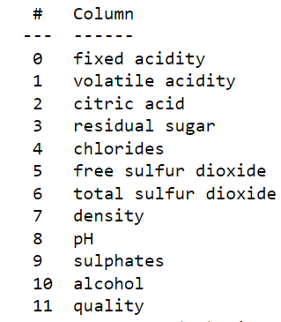
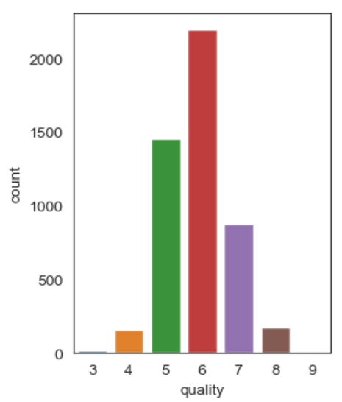
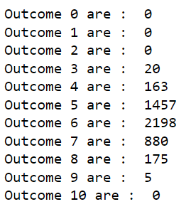
The Attributes of the Wine Quality Dataset
Fig. 1
Notes:
What we see here are the ten attributes that make up the columns of the training and testing datasets which will eventually be used to predict the value of the target variable column-11, the quality attribute.
Figure 1 shows the relative abundance of the various classes in the imbalanced wine quality dataset with Classes 5,6 and 7 having the greatest abundance amount the various classes.

Slide 6
Techniques for Handling Imbalanced Data Sets
Challenges in Predictive Modeling with Imbalanced Data Sets
Bias in models towards the majority class
Inadequate representation of minority class
Limitations in model performance and accuracy
Difficulty in evaluating model performance
Notes:
Predictive modeling with imbalanced data sets poses several challenges impacting model performance and accuracy. One of the main challenges is bias in models towards the majority class, which can result in an inadequate representation of the minority class. This can lead to model performance and accuracy limitations, making it difficult to predict outcomes accurately for the minority class. To address these challenges, synthetic data generation can artificially balance the data set, allowing for an equal representation of the minority class. Furthermore, evaluating the performance of models in imbalanced data sets can be challenging, as traditional metrics such as accuracy may not reflect the performance of the minority class, making the use of synthetic data even more valuable.

Slide 7
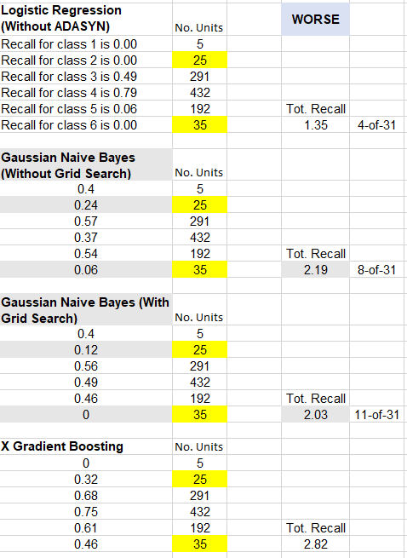
Imbalanced Multiclass Datasets Challenge Standard Machine Learning Algorithms
Notes:
Imbalanced multiclass datasets pose a challenge for standard machine learning algorithms like Logistic Regression, Gaussian Naive Bayes, and XGBoost. These algorithms tend to be biased towards majority class(es) and have low accuracy for minority class(es). A study showed that using Grid Search to optimize hyperparameters did not improve the poor performance of these algorithms on an imbalanced multiclass dataset. However, using ADASYN to generate synthetic instances of minority class(es) significantly improved the accuracy of all three algorithms, resulting in a more balanced prediction performance. ADASYN is a valuable tool for addressing class imbalance in multiclass classification problems.

Slide 8
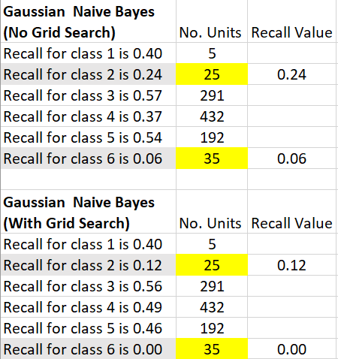
Grid Search Optimization is no Remedy for an Imbalance Dataset
Notes:
Grid optimization or Grid search is a method for tuning the hyperparameters of a machine-learning model by exhaustively searching over a specified hyperparameter grid. It involves training and evaluating a model for each combination of hyperparameters in the grid and selecting the hyperparameters that result in the best performance on a validation set.
As you can see from the results above, the Gaussian Naïve Bayes algorithm performed worse on the imbalanced dataset with the Grid Search, which is evident in the obtained Recall values

Slide 9
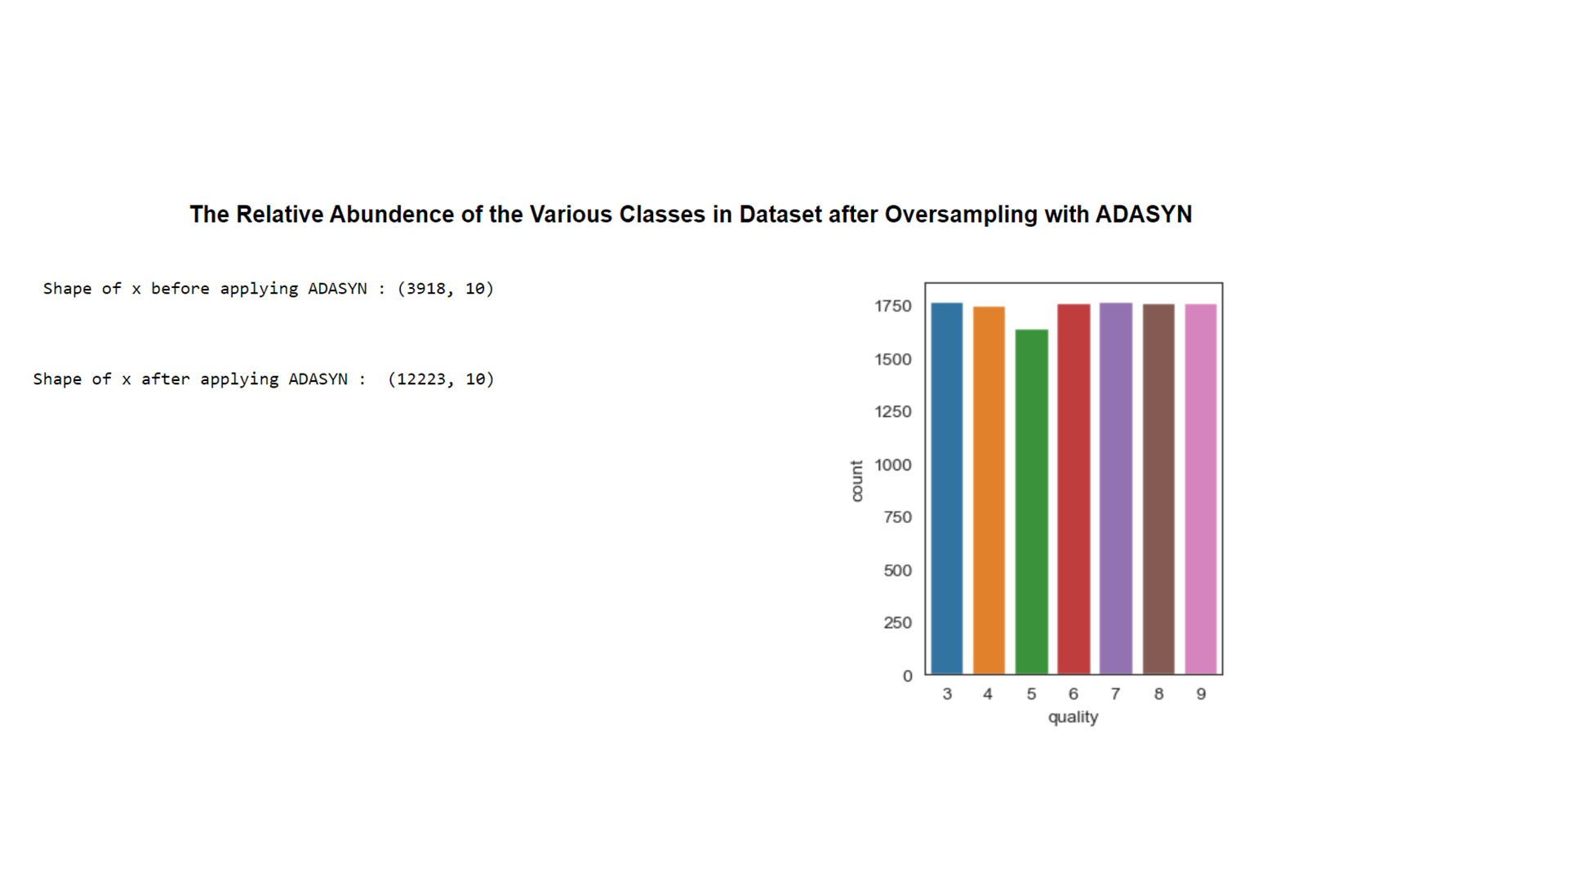
Oversampling of Minority Data Balances Dataset
Fig.2
Notes:
Here we can see the shape of the data frame after having ADASYN applied, where it has grown from 3918 to 12223 rows, wherein in Figure 2, the relative abundance of the various classes is now nearly equal.
ADASYN (Adaptive Synthetic Sampling) is a technique used to handle imbalanced datasets in multiclass classification problems. Imbalanced datasets occur when one or more classes have significantly fewer instances compared to other classes. This can lead to biased model predictions and lower predictive accuracy for the minority class(es). ADASYN overcomes this issue by generating synthetic instances of the minority class(es) to balance the class distribution.

Slide 10
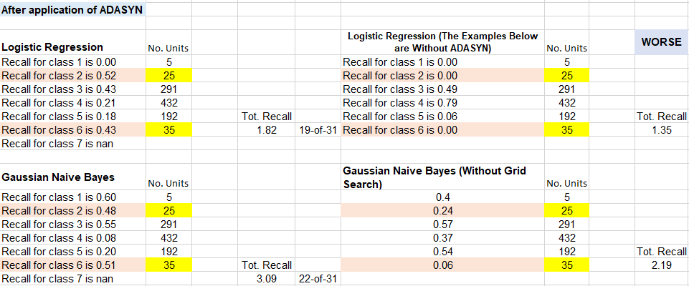
The Utility of Synthetic Data by Comparison of Predictive Accuracy
Notes:
Here we study the utility of synthetic data by comparing the effect of ADASYN on the predictive accuracy of Logistic Regression and Gaussian Naive Bayes, both algorithms were trained and evaluated on a multiclass imbalanced dataset, both with and without ADASYN treatment. The results showed that using ADASYN improved the predictive accuracy of both Logistic Regression and Gaussian Naive Bayes, particularly for the minority class(es). The study demonstrated that ADASYN could be an effective tool for improving the performance of machine learning algorithms in imbalanced multiclass classification problems.

Slide 11
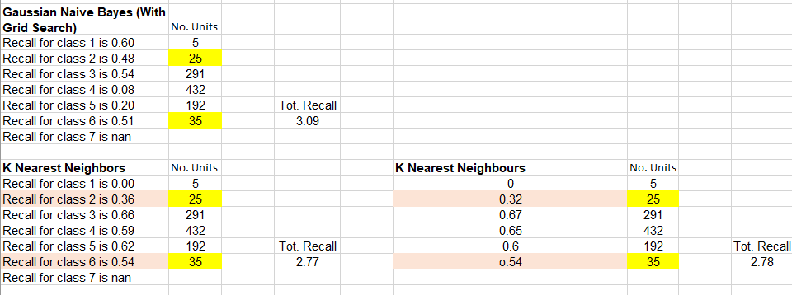
Runners Up in Recall Values after ADASYN Treatment
Notes:
This study highlights the importance of addressing class imbalance in multiclass classification problems, and the effectiveness of ADASYN as a tool for improving the predictive accuracy of machine learning algorithms. Practitioners working with imbalanced multiclass datasets should consider using techniques such as ADASYN to balance the class distribution and achieve better results.

Slide 12
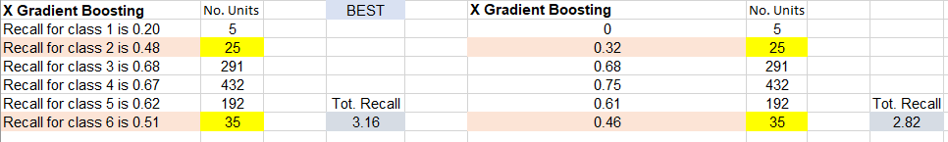
X Gradient Boosting Algorithm: Best in Test
Notes:
The above is an example of the best-performing predictive algorithm of those tested: the X Gradient Boosting algorithm before (right-hand side) and after (left-hand side) dataset treatment with ADASYN.
It is important to remember that accuracy only tends to measure the algorithm’s performance in detecting the true positives. It falls short in considering the False Positives and False Negatives. These False levels brought the predictive AUC despite the illusion of the predictions having higher accuracy that accuracy is a measure of how well the algorithm is becoming at recognizing members of the predominant classes as opposed to being a generalized predictive algorithm.

Slide 13
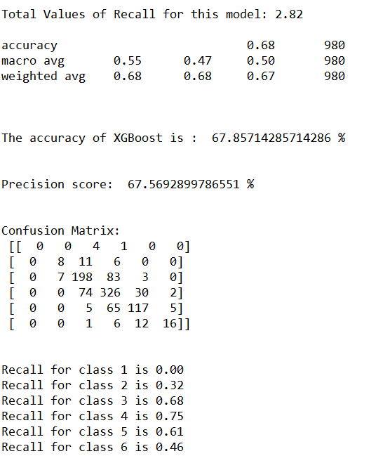
XGBoost: most Effective for our Multiclass Classification Dataset
XGBoost was the best predictive algorithm for a multiclass classification dataset in this study.
The performance of XGBoost improved significantly after the dataset was treated with ADASYN.
The study showed that even the most advanced algorithms must address class imbalance to achieve optimal performance on multiclass classification problems.
0/5=0%
8/8+11+6=32%
198/198+7+83+3=68%
326/326+74+30+2=75%
117/117+70+5=61%
16/16+12+7=46%
Notes:
This study found XGBoost to be the most effective predictive algorithm for a multiclass classification dataset. However, even XGBoost needed help to achieve good accuracy on the imbalanced dataset. But, after the dataset was treated with ADASYN, XGBoost's performance improved significantly. The results showed that using ADASYN to balance the class distribution made XGBoost and other algorithms tested more effective in predicting the minority class(es). The study demonstrated that even the most advanced algorithms must address class imbalance to achieve optimal performance on multiclass classification problems.

Slide 14
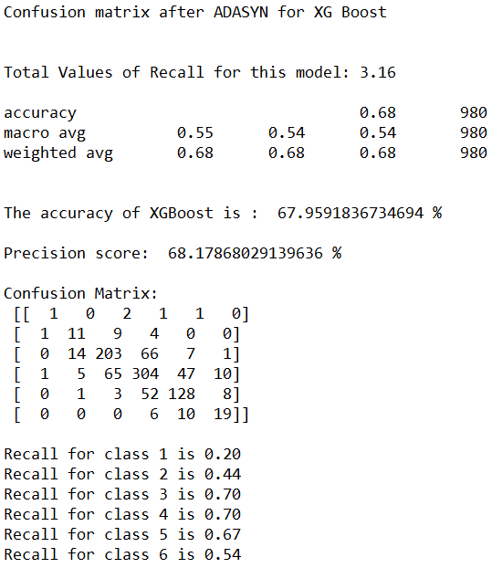
Notable Improvement in the Predictive (Recall) of Minority Classes
The accuracy and precision scores went up. There are improvements in the predictive accuracy (Recall) scores of all the Minority Classes.
The accuracy of the predictions of the Minority Classes has gone from 0%, 32%, and 46%, respectively, to 20%, 44%, and 54% due to the ADASYN technique using the XGBoost classification prediction algorithm.
Class-1 20% vs. 0.0%, an increase of 20% [5 members]
Class-2 44% vs. 32%, an increase of 12% [25 members]
Class-3 70% vs. 68%, an increase of 2% [291members]
Class-4 70% vs. 75%, a decrease of 5% [432 members]
Class-5 67% vs. 61%, an increase of 6% [192 members]
Class-6 54% vs. 46%, an increase of 8% [35 members]
The minority datasets:
Class-1 only has 5 members in the test dataset [5/432=1.2%]*
Class-2 only has 25 members in the test dataset [25/432=5.8%]*
Class-6 only has 35 members in the test dataset [35/432=8.1%]*
*The respective relative ratios to the largest majority dataset.
Notes:
As you can see, the accuracy and precision scores went up, which is great. Still, much more important is that you can see notable changes in the predictive accuracy (recall) of all the minority Classes.
As you can see, the accuracy of the predictions of the Minority Classes has gone from 0%, 32%, and 46%, respectively, to 20%, 44%, and 54% due to “SMOTE-ing” using the ADASYN technique using the XGBoost classification prediction algorithm. The above results in these data sets being put into a more reasonable range of predictive accuracy.
One might notice that the predictive accuracy of the largest Majority Class has taken a slight hit because of the “SMOTE-ing” process, where it has gone from 75% down to 70% Recall, but that is the price that one pays for the ADASYN process.

Slide 15
Case Studies and Real-World Applications
Handling imbalanced datasets is a critical challenge in predictive modeling.
The presentation introduced successful examples of handling imbalanced datasets.
Synthetic data can be used for oversampling minority datasets to mitigate bias in medical resource allocation.
Understanding the pros and cons of each technique is key to making informed decisions and effectively handling imbalanced datasets in any scenario.
Notes:
Handling imbalanced data sets is a critical challenge in predictive modeling that requires a tailored approach. This presentation has introduced several successful examples of handling imbalanced data sets. The oversampling of the minority datasets using synthetic data provides clinical healthcare means to mitigate bias in the allocation of medical resources. To determine the best approach, it is important to consider the impact of different techniques in different scenarios. Techniques such as oversampling with synthetic data provide class weight adjustments that can each have varying effects on model performance thereby a thorough understanding of the pros and cons of each technique is key to making informed decisions and effectively handling imbalanced data sets in any scenario.

Slide 16
Biased Data Leads to Biased Decisions
Consequences of Misclassification in Minority Class
Significant impact on real-world applications
False predictions and incorrect decision making
Unfair treatment of certain groups
Financial losses and reputational damage
Ethical and legal implications.
Notes:
Misclassifications in the minority class can result in false predictions and incorrect decision-making, leading to unfair treatment of certain groups, financial losses, and reputational damage. Additionally, there may be ethical and legal implications to consider. It is crucial to understand the consequences of misclassification in the minority class to mitigate the impact and handle imbalanced data sets effectively in predictive modeling.

Slide 17
Synthetic Data Remedies Bias
Summary:
Synthetic data generation addresses class imbalance in datasets.
Generating new samples of the minority class helps balance class distribution and mitigate bias.
Using synthetic data for oversampling minority classes leads to improved predictive accuracy.
Synthetic data addresses class imbalance and improves machine learning algorithm performance.
Notes:
Synthetic data generation is a technique used to address class imbalance in datasets by generating new samples of the minority class. This helps to balance the class distribution and mitigate the impact of bias towards the majority class. This study has shown that using synthetic data to oversample minority classes can lead to improved predictive accuracy in machine learning algorithms.

Slide 18
THE END
Notes:
Thank you for your time and attention.

